Slide 1
Multi-Robot Coordination in Underwater Mothership-Passenger Systems
Nathan L. Butler, candidate for MS in Robotics
Collaborative Robotics and Intelligent Systems (CoRIS) Institute, Oregon State University
Advisor: Dr. Geoff Hollinger
September 10, 2025
NSF Award No.
2322055

Slide 2
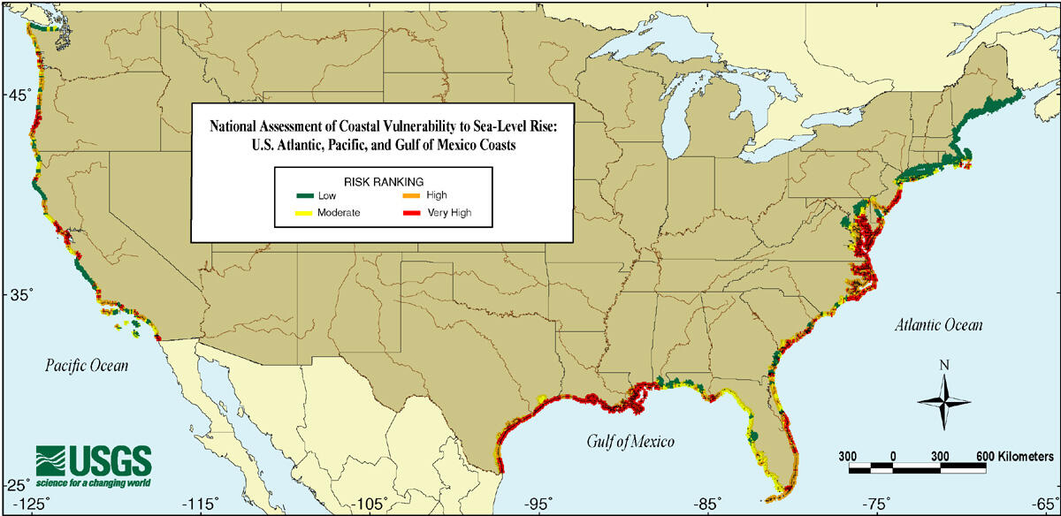
Rising Sea Levels Threaten Coastal Communities
US Geological Survey (2000), Public Domain

Slide 3
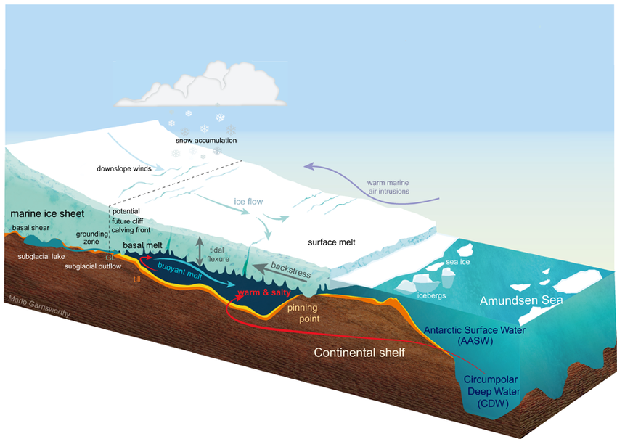
Ocean-Terminating Glaciers are Data-Rich, but Hazardous
Thwaites Glacier
Antarctica
Larter (2022), Geophysical Research Letters
Notes:
Ocean-terminating glaciers are key contributors to sea level rise, as they are melted from both above and below. What are some key challenges that we’d identify for this environment? Narrow, constrained areas, turbulent ocean currents, no surface access.

Slide 4
Exploring with Marine Robots
Notes:
These factors prompt the use of AUVs for exploring this environment. AUVs have been used for marine missions before, however the hazards of the under-ice domain prompt the use of a special type of system that mitigates the risk of expensive equipment loss.

Slide 5
Mothership-Passenger Systems
Deploying multi-robot team in marine under-ice environments
Mothership
Notes:
Here we introduce the Mothership-Passenger system. We note that in this system, there are multiple avenues for coordinating the Passengers.

Slide 6
Coordination in Marine Mothership-Passenger Platforms
Notes:
Other marine Mothership-Passenger systems have attacked MR coordination in these ways. Typically initial mission planning with the Mothership followed by decentralized execution with limited adaptation. While acceptable in relatively short-horizon, static environments, long term deployments in dynamic environments requires methods with enhanced Passenger robot agency/responsiveness. This brings us to our gap.

Slide 7
Research Gap
Notes:
How can we leverage the high compute and global perspective offered by a Mothership to enhance team coordination in decentralized Passenger autonomy routines?

Slide 8
Contributions
Notes:
Merge with outline?

Slide 9
Outline

Slide 10
Hybrid Decentralization for Multi-Robot Orienteering with Mothership-Passenger Systems

Slide 11
T
Multiple robots deploying, visiting task sites, and returning
T
Mothership
T
T
?
T
T
T

Slide 12
Stochastic Multiagent Orienteering Problem
T
T
?
?
T
T
T
T
T
T
?
?
?
?
T
Unvisited
(exceeds budget)
?
T
T
Mothership
Notes:
MOP/SMOP slide

Slide 13
How can we leverage a hybrid centralized-decentralized network available in Mothership-Passenger systems to solve complex orienteering problems?
Notes:
Gap

Slide 14
Hybrid Mission Planning
Observed local data
Received global data
Passenger k
Use up-to-date local observations
Respond quickly to local disturbances
Mothership
Use aggregated global information
Coordinate system-level actions
Locally-informed plans
Globally-informed plans
Decentralized Planning
Centralized Planning

Slide 15
Decentralized Planning
Passenger k
Dec-MCTS
Neighboring Robots
Plan Valuation & Selection
Candidate Plans
Notes:
TODO (opt.) discuss planning distribution

Slide 16


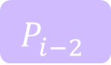

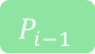
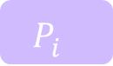
Centralized Planning
Mothership
Mothership
Centralized Solver
(Sim-BRVNS [X])
SimBRVNS
$$P_{i−2}^{}$$
$$P_{i}^{}$$
$$P_{i−1}^{}$$
$$P_{j}^{}$$
$$P_{i}^{}$$
$$P_{k}^{}$$

Slide 17
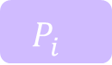


Hybrid Framework
Mothership
Passenger k
SimBRVNS
Stored Plans
Dec-MCTS
Neighboring Robots
Plan Valuation & Selection
$$P_{i}^{}$$
$$P_{j}^{}$$
$$P_{k}^{}$$
Candidate Plans

Slide 18
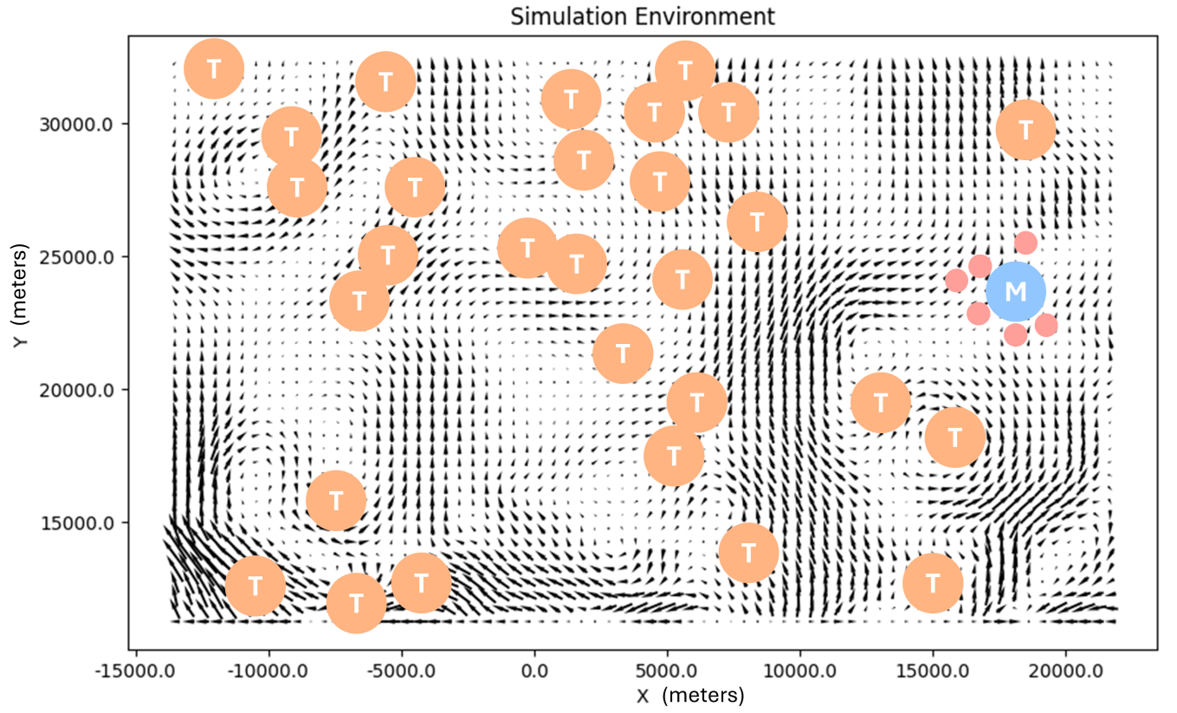
Evaluation in Simulated Ocean Domain
Tasks (T)
Mothership Location (M)
Deployed Passengers

Slide 19
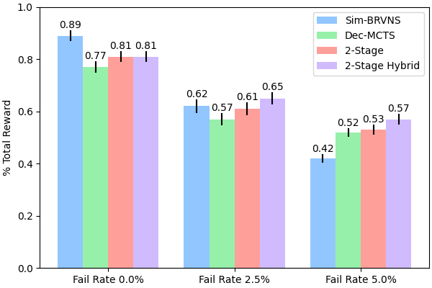
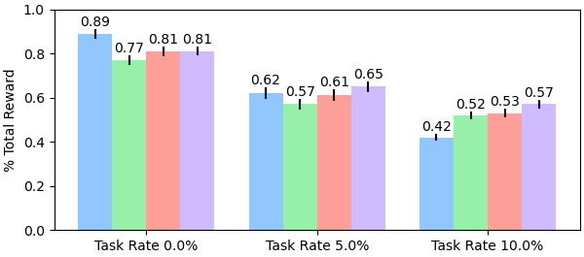
Experimental Results
Algorithms evaluated:
Initial, centralized solution only
Decentralized planning only
6 Robots, 20 Tasks
Initial + decentralized replanning
Initial + hybrid replanning
Task Completion Rate (Higher is better)
Initial (centralized) solution -> immediate coordination boost
Mothership-assisted replanning -> greater resilience to disturbances

Slide 20
Opt. Second Graph

Slide 21
Hybrid-Decentralized Discussion

Slide 22
Contribution 1 Conclusions
Introduced Stochastic Multiagent Orienteering Problem
Explored leveraging mothership for hybrid decentralized problem solving
Evaluated scenarios where integrated mothership provides greatest benefits

Slide 23
Contribution 1 Publications
N. Butler and G. Hollinger, “ Hybrid Decentralization for Multi-Robot Orienteering with Mothership-Passenger Systems ,” in Proc. of the 42nd IEEE International Conference on Robotics and Automation, Atlanta, GA, May 2025.
N. Butler, G. Hollinger, J. Garwood, Y. Si, and A. Stewart, “Pseudo-Centralized Mission Planning for Under-Ice Robotic MOTHERSHIPs” [Poster]. 2nd Northwest Robotics Symposium, Corvallis, OR, April 2024.

Slide 24
Learning-Based Coordination for Passenger Robots with Multiple Objectives

Slide 25
Multi-Robot Coordination for Complex Tasks
Notes:
Real world sees complex tasks that may require multi-robot coordination.
Could discuss IvP Helm here

Slide 26
Decentralized, Role-Based Coordination
Notes:
Here are some methods (Focus on adaptability required alongside intermittent communication):

Slide 27
How can we coordinate and adapt multi-robot roles for dynamic, comms-constrained environments using a Mothership-Passenger system to execute complex tasks?
Notes:
How can we coordinate, and adapt multi-robot roles for dynamic, low-comms environments using a Mothership-Passenger system?

Slide 28
Mothership-Adapted Coordinated Passenger Specializations
Notes:
Let’s try taking advantage of some domain knowledge without intensive, rigid behavior engineering (Maybe not include: or complex reward functions)?

Slide 30
Conclusions

Slide 31
Thesis Summary

Slide 32
Future Work

Slide 33







TODO: List committee
Contact:
Nathan Butler: butlnath@oregonstate.edu
Dr. Geoffrey Hollinger: geoff.hollinger@oregonstate.edu
NSF Award No.
2322055

Slide 34
Image References
TODO: How to best do these in slides?
[1] Larter, Robert. (2022). Basal Melting, Roughness and Structural Integrity of Ice Shelves. Geophysical Research Letters. 49. 10.1029/2021GL097421.

Slide 35
Marine Mothership-Passenger Platforms
MOOS-IvP + IvP Helm: Tends to treat Passengers only as executors, with no agency (no decentralized planning). IvP-Helm coordinates Passenger behaviors (rigid).
Behaviors: ConstantDepth/Speed, AvoidObstacles, Loiter, Surface, Waypoint etc.
These are not really planning-type behaviors that support mission-level coordination between robots
Coordinating Multiple Autonomies to Improve Mission Performance adds “Neptune,” which is sort of a Mothership-like entity

Slide 36
Marine Mothership-Passenger Platforms
Dynamic Mission Planning Framework for Collaborative Underwater Operations Using Behavior Trees: plans missions on Mothership, executes on Passengers (no replanning, limited adaptation/coordination)
Distributed task allocation and mission planning of AUVs for persistent underwater ecological monitoring and preservation
Initially centralized (not necessarily on Mothership), then decentralized

Slide 37
Gap
Most current methods favor centralized planning, decentralized execution (with minor adjustments). Not satisfactory for dynamic environments or long-range missions (must have greater decentralized autonomy).
So, how can we enhance decentralized autonomy with Mothership?
(in ways that IvP Helm cannot? I guess IvP Helm doesn’t natively plan, just adapts behaviors according to external specs…)

